Slide 1


APPLY
Cross Apply (no null values) and Outer Apply (include null values)
Apply is like join, but one side of the apply is a table valued expression, in which a value (usually a column) in each row of the other side of the apply is passed into that expression.
https://www.mssqltips.com/sqlservertip/1958/sql-server-cross-apply-and-outer-apply/

Slide 2
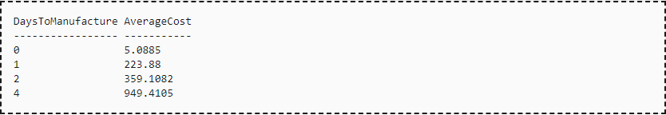
Pivot
Pivot (aggregation) rotates a table valued expression 90 deg. and turn values in one column into multiple columns. Unpivot is the opposite operation

Slide 3
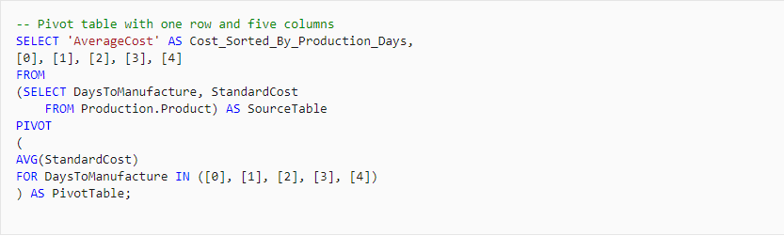

Pivot

Slide 4
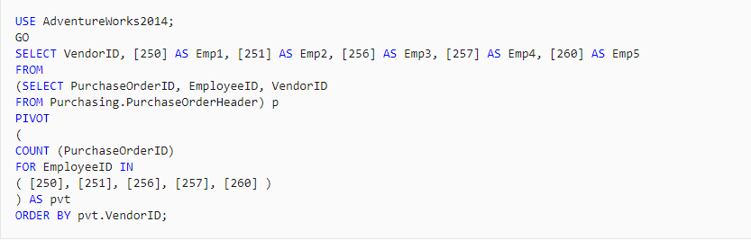
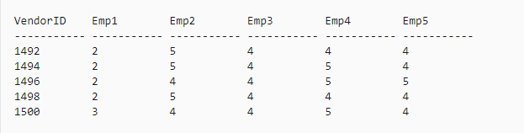
Pivot

Slide 5
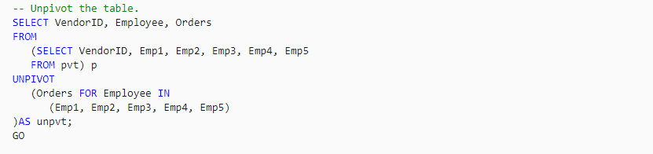
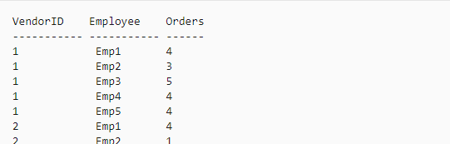
UnPivot
Unpivot removes NULL values in the pivoted table and it can’t reverse the aggregation
here we only get the total orders for each employee from each vendor
you have to list all possible values/cols from your pivoted table

Slide 6
Cube (T-SQL)
Cube is a subclause of Group By. Used to generate multiple grouping sets. It creates “group by”s for all possible combinations of columns.
For cube(a,b), it generates (a,b), (a,null), (null,b) and (null,null)
https://www.sqlservertutorial.net/sql-server-basics/sql-server-cube/
Example in next slide

Slide 7
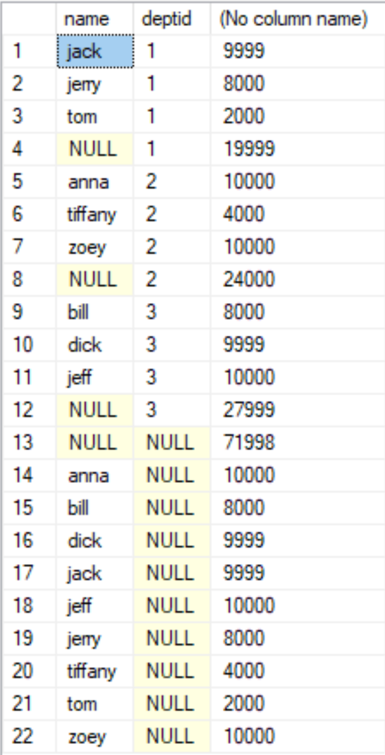
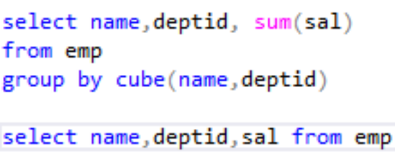
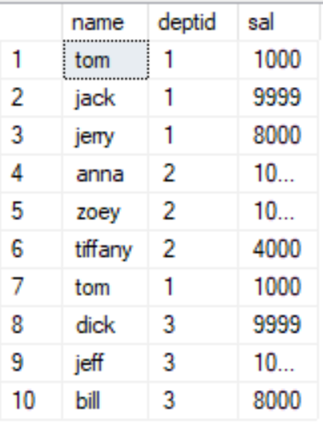
Cube (T-SQL)

Slide 8

Rollup
the ROLLUP operator is used to calculate sub-totals and grand totals for a set of columns passed to the “GROUP BY ROLLUP” clause
ROLLUP creates a hierarchy based on the columns passed in
in the below example, rollup will create group set according to
country + region
country only
all countries + all regions

Slide 9
Cube vs Rollup
CUBE will produce all possible combinations
country + region
country only
all country + all regions
region only -> 2nd level in the hierarchy, skipped in ROLLUP
in the below example, ROLLUP will create group set according to
country + region
country only
all countries + all regions
https://www.sqlservercentral.com/articles/the-difference-between-rollup-and-cube

Slide 10
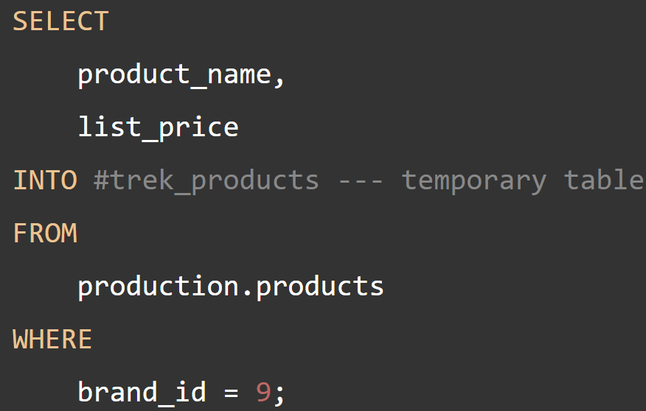
Temp Tables
Stored in tempdb, physical table, with ALMOST all the features of normal tables.
Declare using #tableName or ##tableName
Create temp tables with
CREATE TABLE
SELECT INTO
Suitable for temporarily storing a large set of data.

Slide 11
Temp Tables
Local temp tables start with #
only useable within the current session/connection
local temp tables are automatically dropped when you close the connection that created it.
Global temp tables start with ##
useable across all connections
global temp tables are dropped once the connection that created it closed and the queries against this table from other connections completes.
You can also drop temp tables manually with DROP TABLE #xxxxx

Slide 12
Local Variable
an object that can hold a single data value of a specific type, typically used:
As a counter, often in loops
To hold a data value to be tested by a control-of-flow statement.
To save a data value to be returned by a stored procedure or function.

Slide 13
Local Variable
Declare a variable with the DECLARE keyword
variables can only be referenced in the batch/procedure it’s declared
https://docs.microsoft.com/en-us/sql/t-sql/language-elements/variables-transact-sql?view=sql-server-ver15
Examples on next page

Slide 14
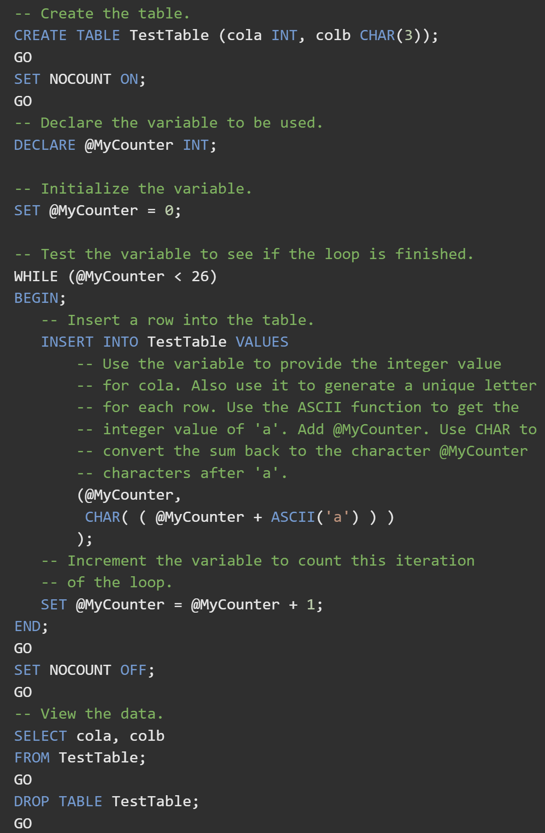
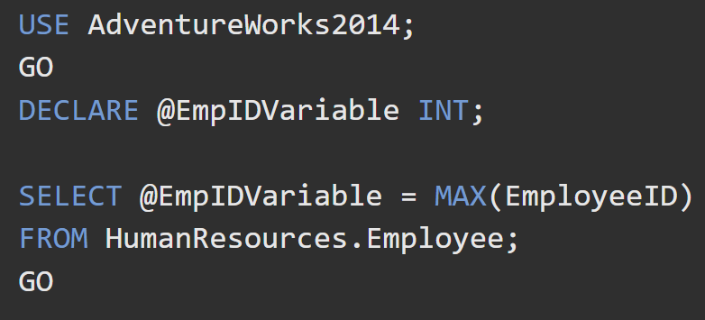
Local Variable
*If a SELECT statement returns more than one row and the variable references a non-scalar expression, the variable is set to the value returned for the expression in the last row of the result set.

Slide 15
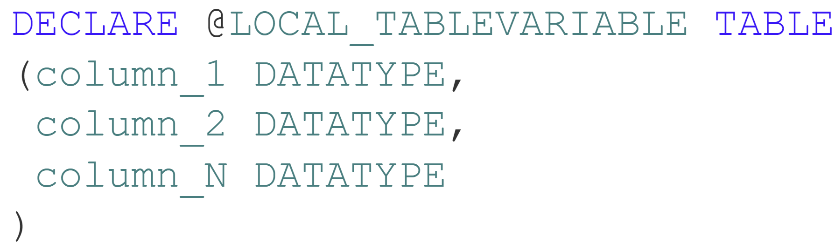
Table Variable
a special type of local variable that helps to store data temporarily
insert, update, delete are all allowed just like on a regular table
PK,unique, not null, check constraints are all supported, but not FK
truncate, alter, explicit indexes are not allowed
indexes can be created implicitly through PK and Unique constraints
rollback has no effect on table variables

Slide 16
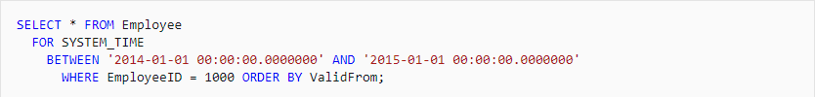
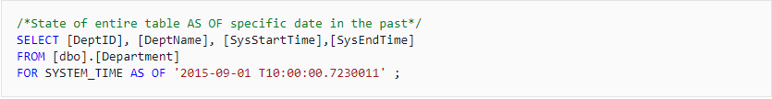
Temporal Table
A table maintains its historical information automatically.
It has a data table and a history table. Two columns of datetime2 and a PERIOD column will need to be added to those tables.
Based on command, rows for a certain time will be returned automatically.
Use “As Of”, “FROM TO”, “Between And”, “Contained In” and “All” to query the data.
Select * will not return hidden columns.

Slide 17
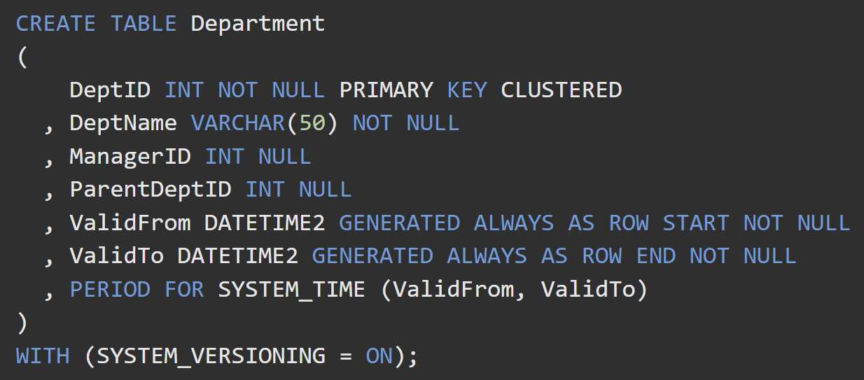
Temporal Table

Slide 18
Temp Table vs Table Variable
Temporary Table | Table Variable
Temporary tables can be used in Stored Procedures, Triggers and Batches but not in user defined functions | Table variables can be used in user defined functions, stored procedures, and batches
Local temporary tables are temporary tables that are available only to the session that created them. Global temporary tables are temporary tables that are available to all sessions and all the users. | Its scope is in the stored procedure, user defined function or batch where it is declared like any local variable we create with a DECLARE statement.
Local temporary tables are automatically destroyed at the end of the procedure or session that created them. Global temporary tables are dropped automatically when the last session using the temporary table has completed We can also drop temporary tables explicitly using drop command similar to normal table. | Table variables are automatically cleaned up at the end of the user defined function, stored procedure, or batch in which they are defined.
Temporary table name can be of maximum 116 characters | Table variable name can be of maximum 128 characters
PRIMARY KEY, UNIQUE, NULL, CHECK etc can be implemented at the time of creating temporary tables using CREATE TABLE statement or can be added after the table has been created. FOREIGN KEY not allowed. | PRIMARY KEY, UNIQUE, DEFAULT values, NULL, CHECK can be added, but they must be incorporated with the creation of the table in the DECLARE statement. FOREIGN KEY not allowed.

Slide 19
Temp Table vs Table Variable
Temporary Table | Table Variable
Temporary table supports adding Indexes explicitly even after creation and it can also have the implicit Indexes which are the result of Primary and Unique Key constraint. | Table Variables doesn’t allow the explicit addition of Indexes after it is declared, the only means is the implicit indexes which are created as a result of the Primary Key or Unique Key constraint defined at the time of declaring Table Variable.
Temporary tables can also be directly created and data can be inserted using Select Into statement without creating a temporary table explicitly. | Table variables can’t be created using Select Into statement because being a variable it must be declared before use
The SET IDENTITY_INSERT statement is supported in temporary table | The SET IDENTITY_INSERT statement is not supported in table variables
We can’t return a temporary table from a user-defined function | We can return a table variable from a user-defined function
Temporary Table can be truncated like normal table | Table variables can’t be truncated like normal table or temporary tables.
Stored Procedures will not recompile for every run | When using temp variable in Stored Procedures, the SP will recompile for every subsequent calls.
All DML will be rolled back when rolling back a transaction | Changes to the data will not be rolled back when rolling back a transaction

